Slide 1
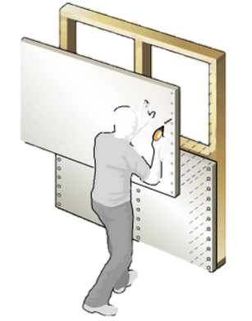
Next Generation Drywall
Alexsandra Villarreal
Daniel Quezada
Faculty Advisor:Dr. Sarkar & Dr.Jones
Course Advisor: Dr. Sarkar
Ivonne Martinez

Slide 2



Next Generation Drywall
Daniel Quezada
Alexsandra Villarreal
Ivonne Martinez
Faculty Advisor:Dr. Sarkar & Dr.Jones
Course Advisor: Dr. Sarkar

Slide 3
Outline
Problem Formulation
  Elevator Speech
  Background Research
  Competitive Products
  Needs & Wants
  Goals, Objectives & Constraints
  QFD
Concept Development
  Functional Decomposition
  Methodology
  Concept Generation
  Product Concept
Design Embodiment
  Engineering Analysis
  Proposed Product
  BOM
Design for Manufacturability
Manufacturing Process
Design Validation
  Test Protocols
  Safety Analysis
  Economic Analysis
Summary
References

Slide 4
PROBLEM FORMULATION

Slide 5

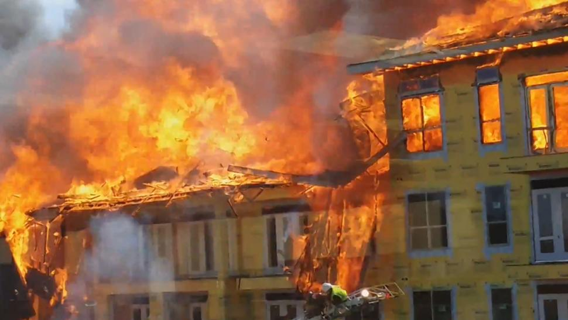
Elevator Speech
  Problem Definition
    Fire resistant drywalls are more expensive.
    Not commonly used in residential constructions.
  Impact
        Manufacture Next Generation drywall
        Affordable price with the ability to resist fire
        Better Insulation
        Better acoustic attenuation

Slide 6
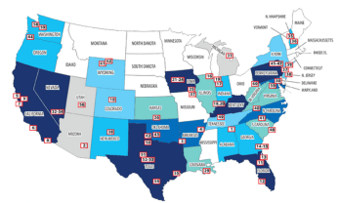
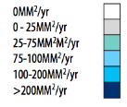



Market Research
The US produces 28% of the world's gypsum wallboard production.
Total Capacity of 12,866M m^2/yr.
2nd
1st
3rd
National Gypsum
  Capacity: 830M m²/yr.
Georgia Pacific
  Capacity: 600M m²/yr.
USG
  Capacity: 835M m²/yr.
4th
CertainTeed Gypsum
  Capacity: 500M m²/yr.
5th
American Gypsum
  Capacity: 308.6M m²/yr.
6th
PABCO
  Capacity: 147M m²/yr.

Slide 7



MARKET RESEARCH
Total Market (m2/yr.) | 12,866M
Name | Location | website | Product Info | Contact Info | Production
Toughrock | Atlanta GA | www.buildgp.com | 5/8-in x 4-ft x 8-ft Fire Resistant Drywall Panel | Lowes's & Georgia Pacific Building Products | 600M m2/yr.
Gold Bond | Charlotte, N.C. | www.nationalgypsum.com | 5/8-in x 4-ft x 8-ft Fire Resistant Drywall Panel | Lowe's & National Gypsum | 830M m²/yr.
SHEETROCK | Chicago, IL | www.USG.com | 5/8 in. x 4 ft. x 8 ft. Tapered Edge Gypsum Board | Homedepot & USG | 835M m2/yr.
Continental BP | Herdon VA | www.Continental-bp.com | Fire Check 0.625-in x 4-ft x 8-ft Fire Resistant Drywall Panel | Info@continental-bp.com

Slide 8


COMPETITIVE PRODUCT SUMMARY
Features | Toughrock | Gold Bond | SHEETROCK | Continental BP
Firecheck® Type X | ✔ | ✔ | ✔ | ✔
Weight (5/8" x 4' x 8') | 70.4 lb | 70.4 lb | 70.4 lb | 72.32 lb
Noncombustible gypsum core |  |  |  | ✔
Glass fibers |  |  |  | ✔
Flexibility | ✔ | ✔ | ✔ | ✔
Price | $10.97 | $10.97 | $9.14 | $10.97
GridMarX® guide marks |  | ✔
GREENGUARD Certified |  | ✔ |  | ✔
Company | Georgia Pacific | National Gypsum | USG | Continental BP

Slide 9
Needs & Wants

Slide 10
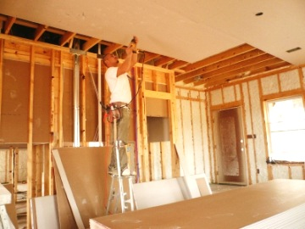
Needs (Customer Requirements)
High quality product on a affordable cost of less than $12 per sheet (4’X8’)
Fire resistant
  ASTM E 119
Type-X Standard
    ASTM C1396
Better (30% more) Insulation
Better Acoustic Insulation

Slide 11
Wants (Customer Expectations)
Lightweight product
( < 71 Lb. per sheet)
Good quality product
High performance Drywall

Slide 12
Goals
Develop Next Generation Drywall w/Advanced Features like High Thermal Insulation, Excellent Fire Retardation, & Acoustic Attenuation
Sustainable design methodology using Recycled Glass

Slide 13
Objectives
Increase thermal insulation by 30% using Nano particles.
Prolongation of fire retardant capacity to more than 20 min.
Maintain weight under 2.2lb/SF
Keep final product cost below $11.00

Slide 14
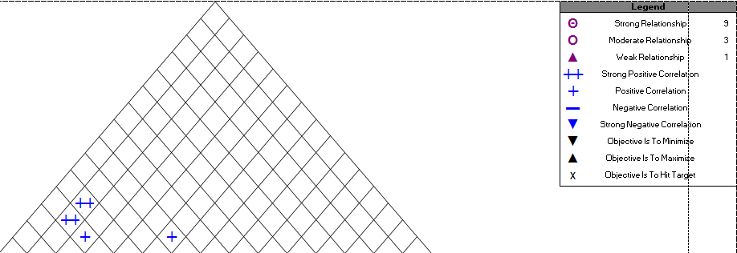
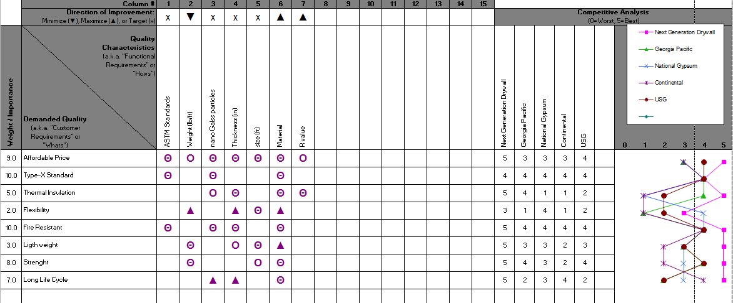
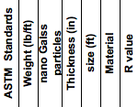
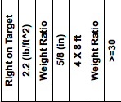
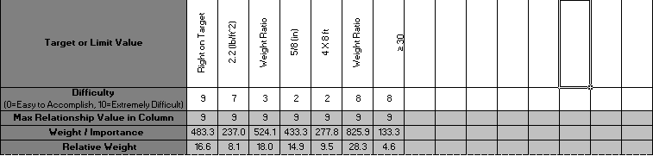
QFD
Needs
Wants
Affordable Price
Type - X
Thermal Insulation
Flexibility
Fire Resistant
Light weight
Strength
Long Life Cycle

Slide 15
CONCEPT DEVELOPMENT

Slide 16
METHODOLOGY
Competitive Product Analysis
Brain Storming
Taking Advantage of Known Characteristics of Glass Nanoparticles

Slide 17
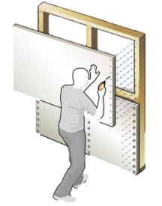
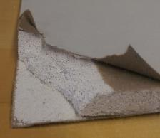
Typical Construction Process
It’s a panel made of gypsum plaster pressed between two thick sheets of paper.
  Cover
    Thick sheets of cardboard paper
  Special Gypsum Plaster
    Gypsum
    Soap
    Nano Glass Particles
    Water
Thick Sheet of Paper
Gypsum Plaster

Slide 18

Typical Construction Process

Slide 19
Engineering Challenge
How to make equivalent sheets of drywalls using standard materials & Proposed Next Generation drywalls of varying compositions using different amounts of glass nanoparticles?
Develop reproducible samples by designing your own mold!

Slide 20
Functional Decomposition

Slide 21


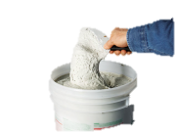
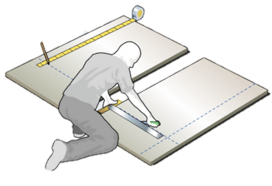
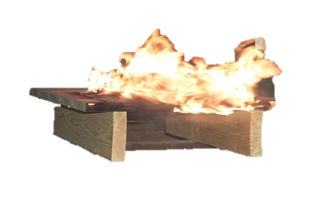
Functional Decomposition for
Next Generation Drywall
Mold
Gypsum Plaster
Testing

Slide 22
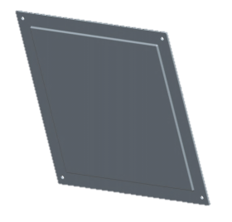
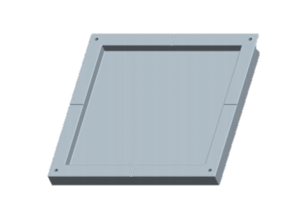
Sub Function I
Mold
Design Constraints
Cost
Heat Resistant
Manufacturability
Concept Variants
Steel
Aluminum
Plastic
Mold | Cost | Heat Resistant | Manufacturability | Row Sum | Nominal Score (Rel. Weight)
Cost |  | 2 | 2 | 4 | 0.222
Heat Resistant | 4 |  | 5 | 9 | 0.500
Manufacturability | 4 | 1 |  | 5 | 0.278
Col. Sum | 8 | 3 | 7 | 18 | 1.000

Slide 23
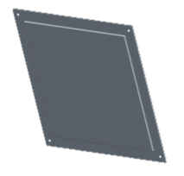
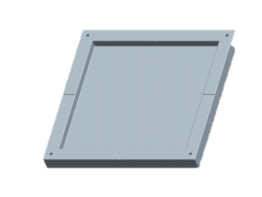
Sub Function I
Mold
COST (min) | Steel | Aluminum | Plastic | Row Sum | Nominal Score (Rel. Weight)
Steel |  | 2 | 1 | 3 | 0.167
Aluminum | 4 |  | 2 | 6 | 0.333
Plastic | 5 | 4 |  | 9 | 0.500
Col. Sum | 9 | 6 | 3 | 18 | 1.000
Heat Resistant > 450° C | Steel | Aluminum | Plastic | Row Sum | Nominal Score (Rel. Weight)
Steel |  | 4 | 5 | 9 | 0.500
Aluminum | 2 |  | 5 | 7 | 0.389
Plastic | 1 | 1 |  | 2 | 0.111
Col. Sum | 3 | 5 | 10 | 18 | 1.000
Manufacturability | Steel | Aluminum | Plastic | Row Sum | Nominal Score (Rel. Weight)
Steel |  | 2 | 2 | 4 | 0.222
Aluminum | 4 |  | 5 | 9 | 0.500
Plastic | 4 | 1 |  | 5 | 0.278
Col. Sum | 8 | 3 | 7 | 18 | 1.000
 | Cost | Heat Resitant | Manufacturability | SCORE
Steel | 0.037 | 0.250 | 0.062 | 0.349
Aluminum | 0.074 | 0.194 | 0.139 | 0.407
Plastic | 0.111 | 0.056 | 0.077 | 0.244

Slide 24
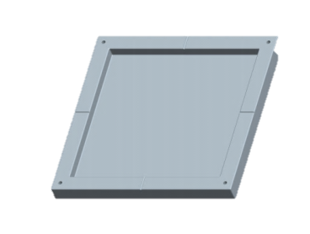
Sub Function II
Special Gypsum Plaster
Design Constraints
Strength
Fire Resistant
Weight
Concept Variants
Type of Gypsum
Nano Glass Particle Reinforcement
Process Time
Gypsum
Soap
Nano Glass Particles
Special Gypsum Plaster
Gypsum Plaster | Strength | Fire Resistant | Weight | Row Sum | Nominal Score (Rel. Weight)
Strength |  | 1 | 4 | 5 | 0.278
Fire Resistant | 5 |  | 5 | 10 | 0.556
Weight | 2 | 1 |  | 3 | 0.167
Col. Sum | 7 | 2 | 9 | 18 | 1.000

Slide 25
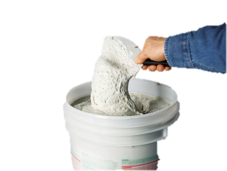

Sub Function II
Special Gypsum Plaster
Strength | Type 0f Gypsum | Nano Glass Particle Reinforcement | Process Time | Row Sum | Nominal Score (Rel. Weight)
Gypsum |  | 2 | 4 | 6 | 0.333
Nano Glass Particles | 4 |  | 4 | 8 | 0.444
Process Time | 2 | 2 |  | 4 | 0.222
Col. Sum | 6 | 4 | 8 | 18 | 1.000
Fire Resistant | Type 0f Gypsum | Nano Glass Particle Reinforcement | Process Time | Row Sum | Nominal Score (Rel. Weight)
Gypsum |  | 1 | 4 | 5 | 0.278
Nano Glass Particles | 5 |  | 6 | 11 | 0.611
Process Time | 2 | 0 |  | 2 | 0.111
Col. Sum | 7 | 1 | 10 | 18 | 1.000
Gypsum
Soap
Nano Glass Particles
Special Gypsum Plaster
Weight (Min) | Type 0f Gypsum | Nano Glass Particle Reinforcement | Process Time | Row Sum | Nominal Score (Rel. Weight)
Gypsum |  | 4 | 2 | 6 | 0.333
Nano Glass Particles | 2 |  | 2 | 4 | 0.222
Process Time | 4 | 4 |  | 8 | 0.444
Col. Sum | 6 | 8 | 4 | 18 | 1.000
 | Strength | Fire Resistant | Weight | Score
Type of Gypsum | 0.093 | 0.154 | 0.056 | 0.302
Nano Glass Particle Reinforcement | 0.123 | 0.340 | 0.037 | 0.500
Process Time | 0.062 | 0.062 | 0.074 | 0.198
 |  |  |  | 1.000

Slide 26
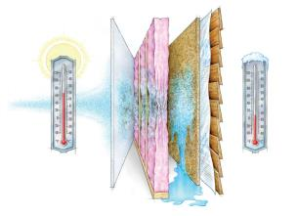
Sub Function III
Testing
Design Constraints
R-Value
ASTM 1396
ASTM 119
Concept Variants
Volume
% Nano Particles
Temperature
Testing | R-Value | STC 57 | ASTM E119 TEST | Row Sum | Nominal Score (Rel. Weight)
R-Value |  | 4 | 3 | 7 | 0.389
ASTM 1396 | 2 |  | 1 | 3 | 0.167
ASTM E119 TEST | 3 | 5 |  | 8 | 0.444
Col. Sum | 5 | 9 | 4 | 18 | 1.000

Slide 27
Sub Function III
Testing
R-Value | Volume | % Nano Particles | Temperature | Row Sum | Nominal Score (Rel. Weight)
Volume |  | 2 | 1 | 3 | 0.167
% Nano Particles | 4 |  | 4 | 8 | 0.444
Temperature | 5 | 2 |  | 7 | 0.389
Col. Sum | 9 | 4 | 5 | 18 | 1.000
ASTM 1396 | Volume | % Nano Particles | Temperature | Row Sum | Nominal Score (Rel. Weight)
Volume |  | 4 | 6 | 10 | 0.556
% Nano Particles | 2 |  | 5 | 7 | 0.389
Temperature | 0 | 1 |  | 1 | 0.056
Col. Sum | 2 | 5 | 11 | 18 | 1.000
ASTM E119 TEST | Volume | % Nano Particles | Temperature | Row Sum | Nominal Score (Rel. Weight)
Volume |  | 2 | 3 | 5 | 0.278
% Nano Particles | 4 |  | 4 | 8 | 0.444
Temperature | 3 | 2 |  | 5 | 0.278
Col. Sum | 7 | 4 | 7 | 18 | 1.000
 | R-Value | ASTM 1396 | ASTM E119 TEST | Score
Volume | 0.0648 | 0.0925 | 0.123 | 0.281
% Nano Particles | 0.172 | 0.06481 | 0.198 | 0.435
Temperature | 0.15123 | 0.00925 | 0.123 | 0.284

Slide 28
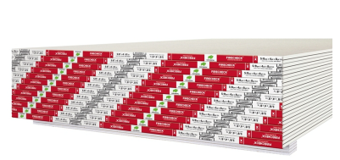
Gypsum Drywall Type X
Special fire-resistance
It provides a greater fire-resistance than regular gypsum board of the same thickness
When tested with the Test Methods E119, shall provide a minimum fire resistance of:
  For 5/8” thickness: one hour
  For ½” thickness: two hours

Slide 29
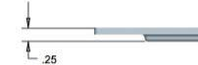
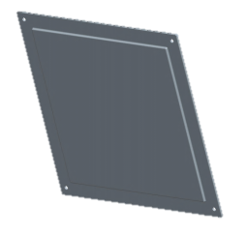
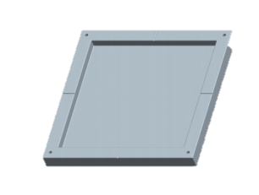
Product Concept
  Mold
    Body (10” X 10” X 1”)
    Lid for 1/2” & 5/8” thickness
½”
(13 mm)
5/8”
(16 mm)

Slide 30
Product Concept (Continued)
Use mold to develop identical samples for comparison
Use various percent of glass nanoparticles
Use similar process conditions to make samples
ASTM E 119-00a standard test specification will need to be adjusted

Slide 31
DESIGN EMBODIMENT

Slide 32
Engineering Challenges
Not standardized sample may result in high variance data.
Fire resistant test temperature not constant
ASTM E 119-00a standard test specification will need to be adjusted
Acoustic tests need be developed using University resources

Slide 33
Engineering Analysis
Thermal conductivity
Samples with 0%, 10%, 20% and 30% Glass nanoparticles tested

Slide 34
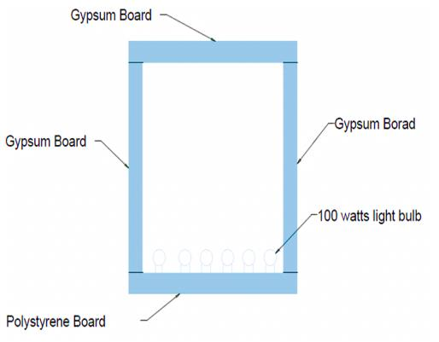
Engineering Analysis
Thermal conductivity
Gypsum board walls
Bottom polystyrene
Plate to hold light blobs
Inside temperature
Known, outside
Temperature measure,
3 thermocouples

Slide 35
Engineering Analysis
International Standard ISO 140/3
Sound Reduction index
Samples with 0%, 10%, 20% and 30% Glass nanoparticles tested

Slide 36
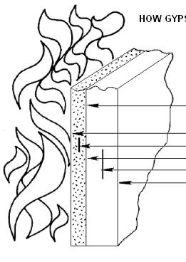
Preliminary/Supportive Experiments
Fire Endurance test
Follows E119 ASTM standard operations
Fixed load applied to sample up to failure
Constant monitoring of temperature, 5 min intervals
Results will be plug into the Time/Temp. graph
5/8’’

Slide 37
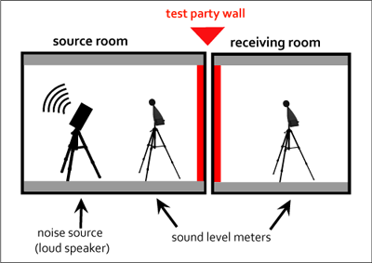
Preliminary/Supportive Experiments
Sound Reduction Index
Box created with sample drywall will be measure for acoustic reduction
Digital sound lever meter use to read the sound pressure
Experiments will be done at specific frequencies AND typical mix as in a music
Results will estimate the sound reduction index at various frequencies and typical noise/music environment

Slide 38
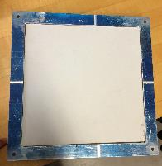

Proposed Product
Gypsum drywall sample
Measurements:
  10” x 10” x 5/8”
  10” x 10” x ½”
Percentage of Glass nanoparticles
0% -control group
10%, 20%, 30%
10 in
10 in

Slide 39
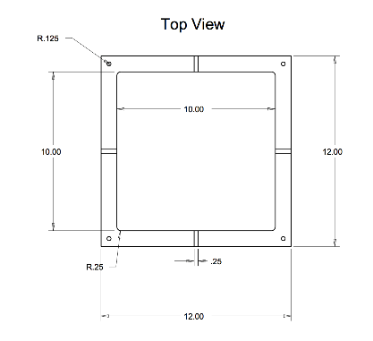
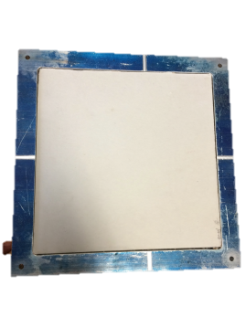
Design for Manufacturability
Scale Mold Prototype
  Mold drawings
10 ft by 10 ft Drywall
  5/8’’ thickness

Slide 40


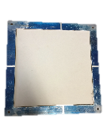
Manufacturing Process
Operation Process Chart
Gypsum Preparation
Chemicals Mixing
Molding
3001
3050
3002
Heating, Mixing, Cooling, Inspect
Heating, Paper layers, Cooling, Inspect
0101
0102
Chemical Treatment, Mixing, Inspect
0103
SA1
A1
Nano Glass Particles
Gypsum
Soap
I1

Slide 41
Manufacturing Process
Precedence Diagram
0103
3001
A1
I1
0100
0101
3002
SA1
3050
0102

Slide 42
DESIGN VALIDATION

Slide 43
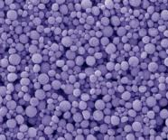
Bill of Materials / Drywall
No Cost

Slide 44
Economic Analysis
Prototype cost of production items

Slide 45
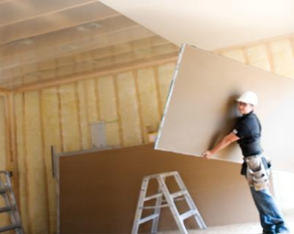
Economic Analysis
Target cost: less than $12.00 dlls.
Retail cost: $10.97 dlls.
Competitive Cost :
$10.00 - $12.00 dlls.
Prototype production cost:
  $97.15 dlls for 12 plates of 5/8” x 12” x 12”

Slide 46
Test Protocols
For a 5/8’’ thickness drywall
Test ID | Test Description | Expected Results | Actual Results
E 119 | Fire Resistance | >= to 1 Hour
E 84 | Flame Retardant | Index <= than 25
C 473 Method A | Hardness | >= than 15 lbf [67 N]
C 473 Method B |  | >= than 11 lbf [49 N]
C 473 Method A (Perpendicular) | Flexural Strength | >= than 150 lbf [667 N]
Method A (Parallel) |  | >= than 50 lbf [222 N]
C 473 Method B (Perpendicular) |  | >= than 147 lbf [654 N]
C 473 Method B (Parallel) |  | >= than 46 lbf [250 N]
C 1396 | Humidified Deflection | <= than 5 eighths of an inch [16 mm]
C 473 Method A | Nail Pull Resistance | >= than 90 lbf [400 N]
C 473 Method B |  | >= than 87 lbf [387 N]

Slide 47
FMEA / Mold
FAILURE MODE AND EFFECTS ANALYSIS FOR MOLD
Process Function | Potential Failure Mode | Severity | Potential Cause(s)/ Mechanism(s) of Failure | Frequency | Current Process Controls | Ability to Detect | RPN
Form and shape drywall | Failure to resist high temperatures | 8 | Improper machine set up | 2 | Operator training and instructions | 6 | 96
 | Breaks | 9 | Improper machine set up | 4 | Operator training and instructions | 8 | 288

Slide 48
FMEA / Drywall
FAILURE MODE AND EFFECTS ANALYSIS FOR DRYWALL
Process Function | Potential Failure Mode | Severity | Potential Cause(s)/ Mechanism(s) of Failure | Frequency | Current Process Controls | Ability to Detect | RPN
Construction Support, Fire Resistance, lower vibration transmission | Not enough fire resistivity | 9 | Not proper gypsum mixing | 4 | Standards Instructions how to prepare gypsum mix | 6 | 216
 | Low soundproof index | 4 | Improper gypsum mixing and not proper thickness | 5 | Standards Instructions how to prepare gypsum mix | 3 | 60
 | Low Humidity | 7 | Not proper gypsum mixing | 5 | Standards Instructions how to prepare gypsum mix | 3 | 105

Slide 49
Safety analysis
Fine nanopowders are safely handled using appropriate gloves & masks

Slide 50
Selected Safety Information for Glass Micro & Nano Particles
Acute Toxicity: None known
Chronic Toxicity: None known
Causes Eye Irritation
May Cause Respiratory Irritation
Avoid Breathing Dust
Wear Personal Protective Equipment (PPE)
Source: MSDS#031512 (Precision Recycling Industries, Cornelius, NC (Revised 03/20/2012

Slide 51
SUMMARY
Identified a new opportunity to build next generation drywalls using glass micro- & nano-particles from recycled glass.
Expected benefits include environment friendly fire resistant materials, more energy savings, & better noise attenuation
Developed reproducible sample drywalls using standard & proposed new drywalls with varying percent of glass nanoparticles
Will use standard test protocols for fire resistance and insulation
Will develop new protocols for noise attenuation using University resources

Slide 52
Gantt Chart
Next Generation Drywall
 |  |  |  |  |  |  |  |  |  | Plan |  |  | Actual |  |  |  | Complete
ACTIVITY | PERIODS
 | 5-Sep | 12-Sep | 19-Sep | 26-Sep | 3-Oct | 6-Oct | 10-Oct | 17-Oct | 24-Oct | 27-Oct | 31-Oct | 7-Nov | 10-Nov | 14-Nov | 17-Nov | 21-Nov | 1-Dec | 5-Dec
Problem Formulation
Elevator Speech
Background Research
Competitive products
Needs and Wants
Goals, Objectives & Constraints
Group presentation 1
QFD
Group presentation 2
Mold - Buy Aluminum
Concept generation
Functional Decomposition
Methodology for Concept Development
Concept Generation
Concept Selection
Product Concept
Group Presentation 3
Mold Making (Milling)
Design Embodiment
Product Drawings
Engineering Challenges/Topics
Engineering Analysis: Tables & Graphs
Preliminary/Supportive experiments
proposed Product
BOM
Group Presentation 4
Design Validation
Test Protocols
Design for Manufacturability
Manufacturing Process
DFMEA
QA Protocols for Parts & Assembly
Design History file (DHF)
Final Report Due
Final Group Presentetaion

Slide 53
References
www.globalgypsum.com
www.buildgp.com
www.nationalgypsum.com/about/index.htm
www.USG.com
www.Continental-bp.com
www.lowes.com
www.Homedepot.com

Slide 54
Questions?
Thank you!

